Slide 1
DIMI: AN OPENAI-POWERED CHATBOT FOR DON MARIANO MARCOS MEMORIAL STATE UNIVERSITY - MID LA UNION CAMPUS Daiben Angelo Sanchez

Slide 2
INTRODUCTION

Slide 3

INTRODUCTION
AI, a transformative technology simulating human intelligence, has advanced fields like education, cybersecurity, and health. Machine learning enables systems to learn and adapt using data models.
AI language models simulate human conversation using machine learning and neural networks, enabling tasks like estimation problem-solving and detection services.
Nazar, 2021; Qian, 2021; Naumov, 2021; Masrom, 2024; Gupta, 2023; Feng, 2020; Xu, 2022

Slide 4
INTRODUCTION
AI-powered chatbots that utilize GPT models have seen adoption in commercial and academic settings for tasks like customer service, education, research validation, and streamlining operations in schools and universities.
This research, titled DIMI: An OpenAI-Powered Chatbot for Don Mariano Marcos Memorial State University - Mid La Union Campus aims to create a chatbot that delivers publicly available university information through human-like conversations.
Kinsella, 2021; Woodland, 2021; Naumov, 2021; Bandera, 2024; Kumarappan, 2024

Slide 5
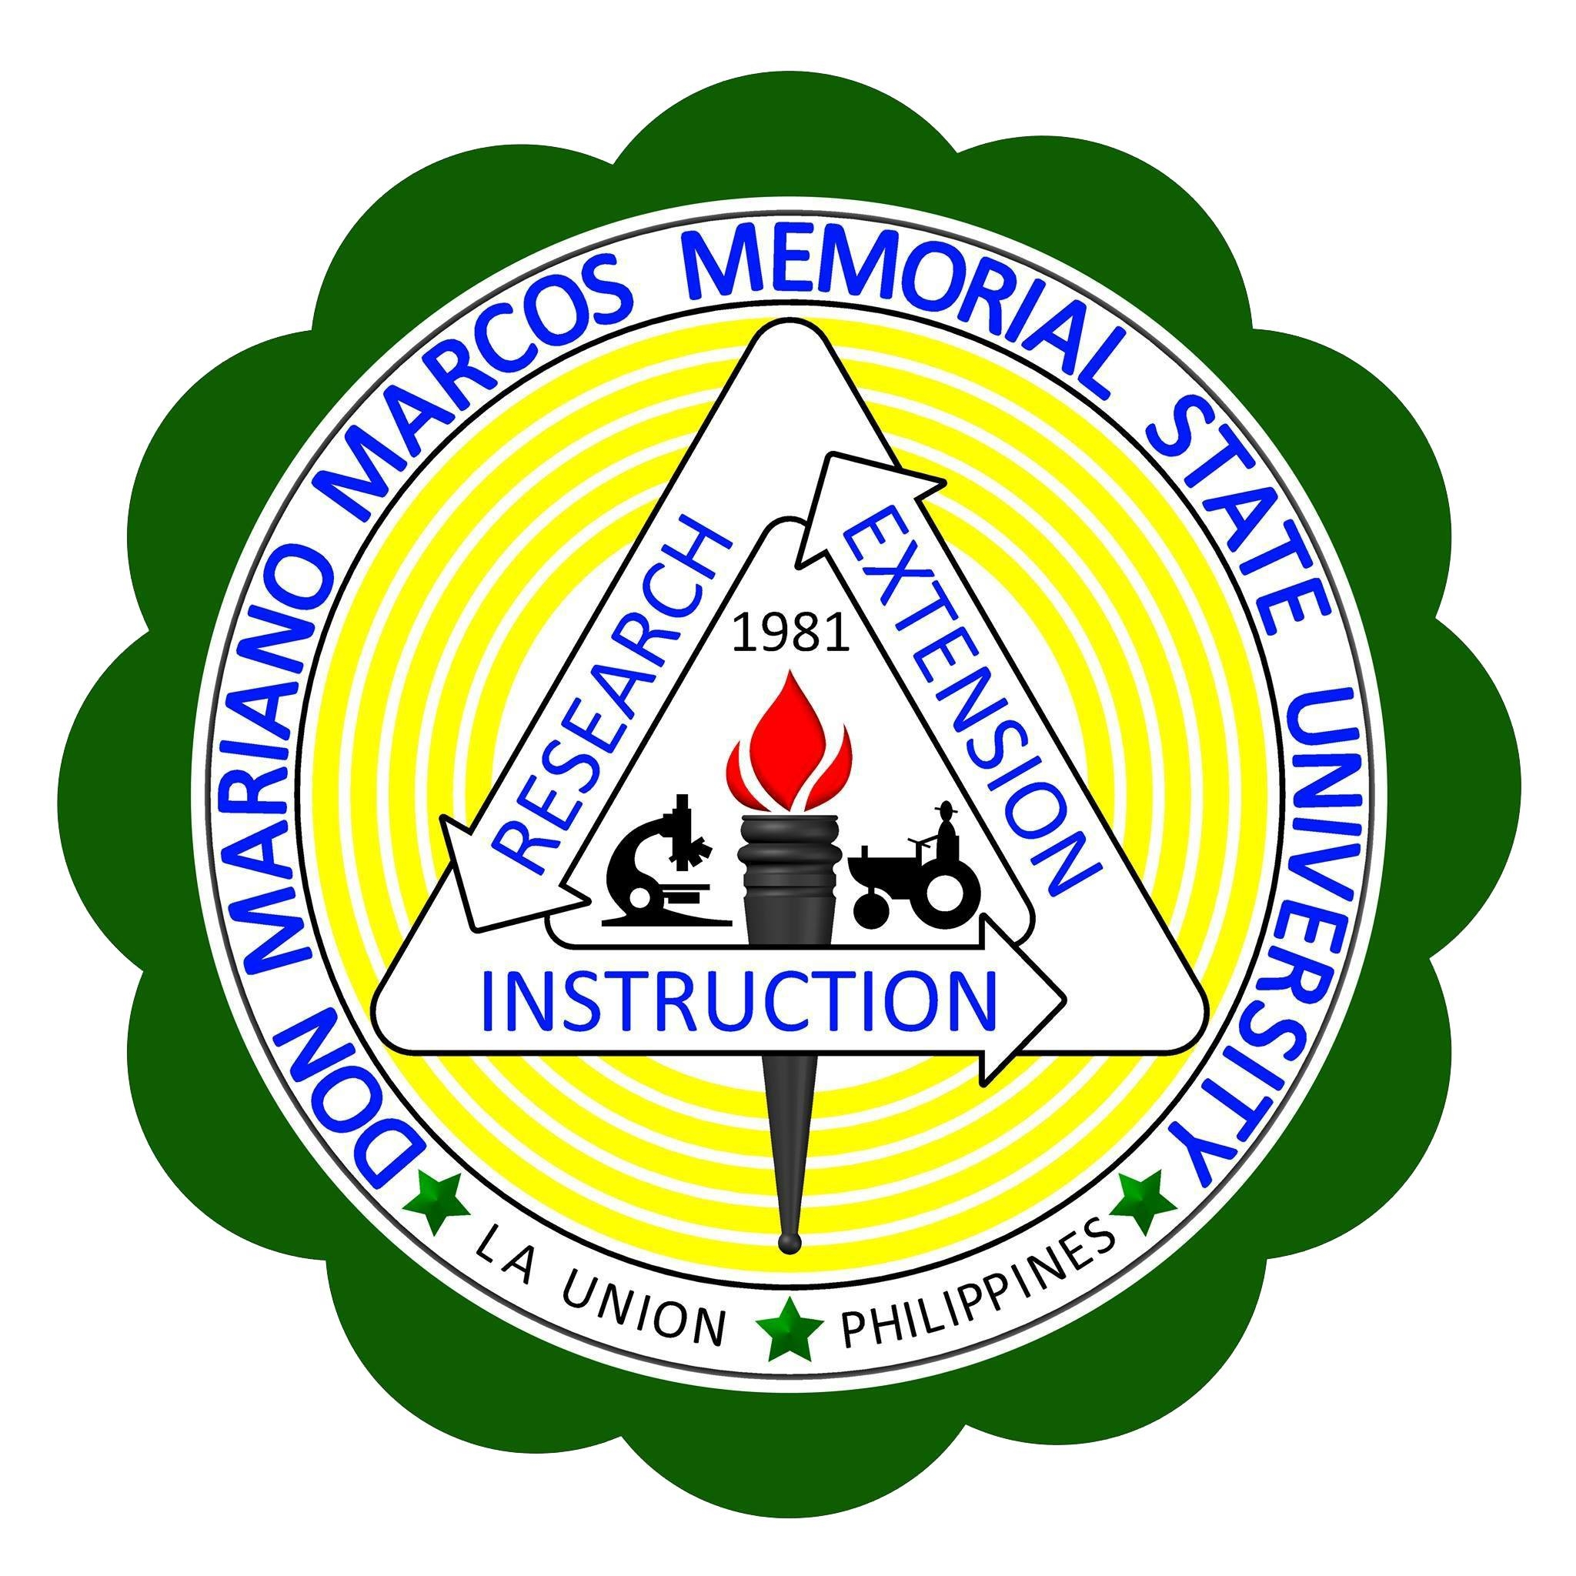
STATEMENT OF OBJECTIVES
This research aims to develop an OpenAI-powered chatbot for Don Mariano Marcos Memorial State University - Mid La Union Campus, designed to provide publicly available university information in a human-like conversational manner via an online chatroom-style interface.
Upon completion, the chatbot will be handed over to the university for their use and discretion.

Slide 6
TIME AND PLACE OF STUDY
The study is being conducted in San Fernando, La Union, as a capstone requirement for the Master’s program at Don Mariano Marcos Memorial State University - Mid La Union Campus.
The project will be completed in 3 months.

Slide 7
RESEARCH DESIGN
The research would be utilizing development research.
Collect data from the DMMMSU official website and retrieve additional details (e.g., tuition fees) on-site.
Organize and structure the collected data to ensure efficient and accurate responses.
Plan, design, develop, and finalize the chatbot.
Deliver the chatbot and its code to DMMMSU-MLUC for their use and management.

Slide 8
METHODOLOGY

Slide 9
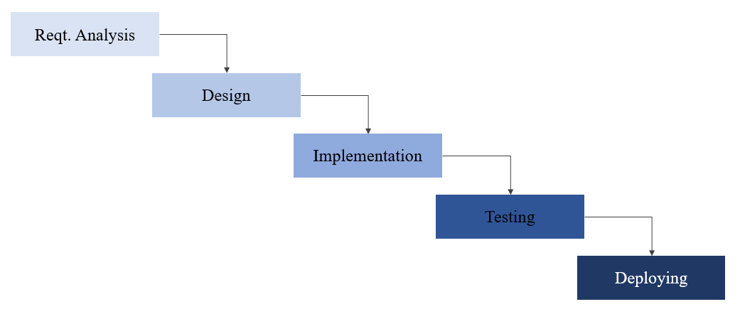
SOFTWARE METHODOLOGY/TECHNOLOGIES
The app development would be utilizing waterfall method approach.
Requirement analysis
Gather publicly available DMMMSU information.
Utilize GPT API usage guide to determine setup requirements.
Design
Create user interface mockups

Slide 10
SOFTWARE METHODOLOGY/TECHNOLOGIES
The app development would be utilizing waterfall method approach.
Implementation
Development would utilize standard web development technologies:
HTML
CSS/Bootstrap
Vanilla Javascript & jQuery
Express.js

Slide 11
SOFTWARE METHODOLOGY/TECHNOLOGIES
The app development would be utilizing waterfall method approach.
Testing
Testing includes stakeholders and non-stakeholders ("participants").
Participants interact with the chatbot freely.
Evaluation forms record prompts, responses, and expectations.
Feedback guides chatbot improvements before deployment.

Slide 12
SOFTWARE METHODOLOGY/TECHNOLOGIES
The app development would be utilizing waterfall method approach.
Deployment
The deployment stage would involve the handover of the chatbot and its code to DMMMSU-MLUC.
The researcher would assist DMMMSU-MLUC by providing an orientation and discussion regarding the code, deployment options, and maintenance.

Slide 13
THANK YOU FOR LISTENING!

